Slide 1
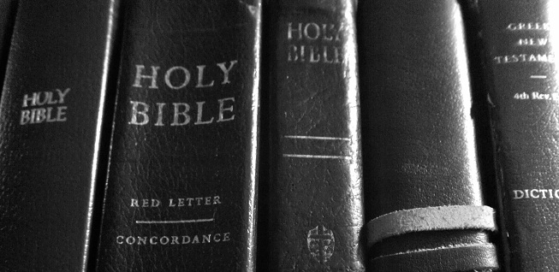
Heritage Basics
Lesson 3: GOD
Notes:
Objectives of Lesson 3:
I. Help you have a fuller understanding of God’s attributes
a. this will help you offer Him truer and more honoring worship
II. To give you a glimpse of the infinite majesty and glory of God.
Class plan:
a. General info on the person of God
b. Survey the attributes of God

Slide 2
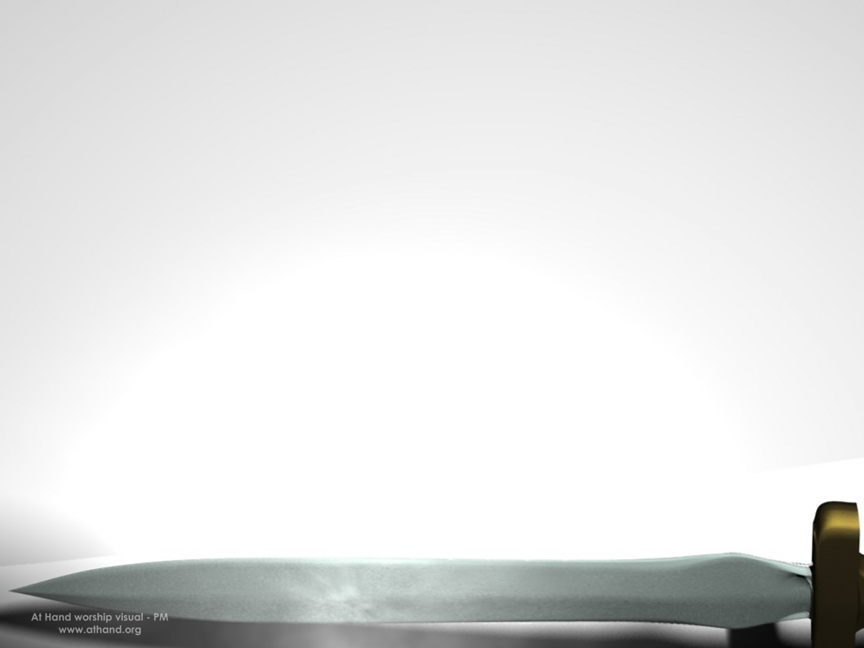
Scripture Memory Verse
1 Chronicles 29:11
Yours, O Lord, is the greatness and the power and the glory and the victory and the majesty, indeed everything that is in the heavens and the earth; Yours is the dominion, O Lord, and You exalt Yourself as head over all.
Notes:
Warm up-Review Memory verse:
<ask volunteers if they can recite last weeks verse>
<Ask volunteers to recite this weeks verse>
ASK: “Would someone read the quote and the INTRO paragraph from your worksheet?”

Slide 3
The Self-existence of GOD
God’s existence is assumed
The significance of His title… “I AM”
God has existed since eternity
  Look at Romans 1:18-22; 2:14-16
Notes:
The self- existence of GOD
God’s existence is assumed- Genesis 1:1
The significance of His title… “I AM”….. It implies self-existence– Exodus 3:14
God has existed since eternity– Isaiah 43:13
ASK: Why do men question the existence of GOD?
ASK: How has God revealed Himself to man?
Look at: Romans 1:18-22; 2:14-16

Slide 4
Romans 1: 18-22; 2:14-16 (NASB)
¹⁸ For the wrath of God is revealed from heaven against all ungodliness and unrighteousness of men who suppress the truth in unrighteousness, ¹⁹ because that which is known about God is evident within them; for God made it evident to them. ²⁰ For since the creation of the world His invisible attributes, His eternal power and divine nature, have been clearly seen, being understood through what has been made, so that they are without excuse. ²¹ For even though they knew God, they did not honor Him as God or give thanks, but they became futile in their speculations, and their foolish heart was darkened. ²² Professing to be wise, they became fools,
Notes:
Talk about: How God has made Himself Evident within men– Romans 1:19
How God can be seen in His creation –Romans 1:20 (also Psalm 19:1)
How God has revealed Himself to men within their conscience—Romans 2:15

Slide 5
Romans 2:14-16 (NASB)
¹⁴ For when Gentiles who do not have ^{t}he Law do instinctively the things of the Law, these, not having the Law, are a law to themselves, ¹⁵ in that they show the work of the Law written in their hearts, their conscience bearing witness and their thoughts alternately accusing or else defending them, ¹⁶ on the day when, according to my gospel, God will judge the secrets of men through Christ Jesus.
Notes:
Talk about: How God has revealed Himself to men within their conscience—Romans 2:15
Ask: “What is the result when men ignore God’s creative power, ignore their conscience, and turn from God?
Answer: Romans 1:21-22-- Their foolish hearts are darkened and they become fools. (See also Psalm 14:1)

Slide 6
There is only one God!
The Father is in heaven
Christ is in heaven at the right hand of the Father
The Holy Spirit is ministering within believers
God is an invisible spirit
God’s glory can be seen
Notes:
Ask the Students for their answers to I,B in the lesson: Talk about there being only one God. (Isaiah 45:22 & 44:6-8)
Note on the Trinity: Once you have established that there is only one God, it is interesting to note that God refers to Himself in the plural. Note Genesis 1:26a and Genesis 3:22. God refers to Himself as “Us” and “Our”. Introduce The Trinity… this will be discussed further in lesson #7. God the Father, God the Son, and God the Holy Spirit are three in one God!
The Father is in heaven– Matthew 6:9; 16:17
Christ is in heaven at the right hand of the Father –Hebrews 10:12
The Holy Spirit is ministering within believers –Romans 8:11; 1 Corinthians 3:16; John 14:26
God is an invisible spirit– John 4:24; Colossians 1:15
God’s glory can be seen—Exodus 24:16-17

Slide 7
Note…
God wants us to know & pursue Him
Notes:
God wants us to know Him & God wants us to pursue Him
This is why we study His Word –in order for us to better know Him.

Slide 8
Knowing God Practically
Set your mind and desires to seek God
          Psalm 27:8
Fill your mind with His Word & Obey
          John 14:21
Learn to fear God; beginning of Wisdom
          Proverbs 9:10
Notes:
Discuss: The fear of God. The fear of God should include practical aspects such as obedience to God’s commandments, falling before God in all humility, and praying.
Ask: How does FEARING God Keep KNOWING God from becoming a casual relationship?
Transition: Knowing God also involves knowing God’s attributes or His characteristics. That is what we will be discussing during the final portion of this lesson.

Slide 9

God’s Attributes
  Eternality– no beginning or end
  Omnipotence – God is all-powerful
  Sovereignty –God is supreme
  Omniscience –God is all-knowing
  Omnipresent—God is everywhere
Notes:
Discuss: The special way in which God’s attributes are different from ours.
For example We cannot possess The following attributes of God…
Eternality– no beginning or end
Omnipotence – God is all-powerful
Sovereignty –God is supreme
Omniscience –God is all-knowing
Omnipresent—God is everywhere

Slide 10
God’s Attributes
  Holiness
  Righteousness and Justice
  Love
Notes:
Discuss: However, some of God’s attributes we can posses, but not to the perfection that God possesses them, Such as:
Holiness
Righteousness and Justice
Love

Slide 11
Harmony of God’s Attributes
  All of God’s attributes work together in perfect harmony.
  For example: God is love and yet God is also just…
Notes:
Ask the class: How does God’s love and God’s justice harmonize together?
Answer: God is love and desires none to perish; so He gave His Son to die in our place.
God is just and will judge man for his sin and for his rejection of Christ.
Rhetorical Questions: Would our society be just if we did not punish a murderer?
Would God be just if he did not punish sinners?
Point: There must be a harmony between God’s attributes.
Transition: Let’s look at some of God’s attributes, and as we do, let’s think about the attributes applications upon our lives.
First, lets look at God’s Holiness. (Section IV)

Slide 12
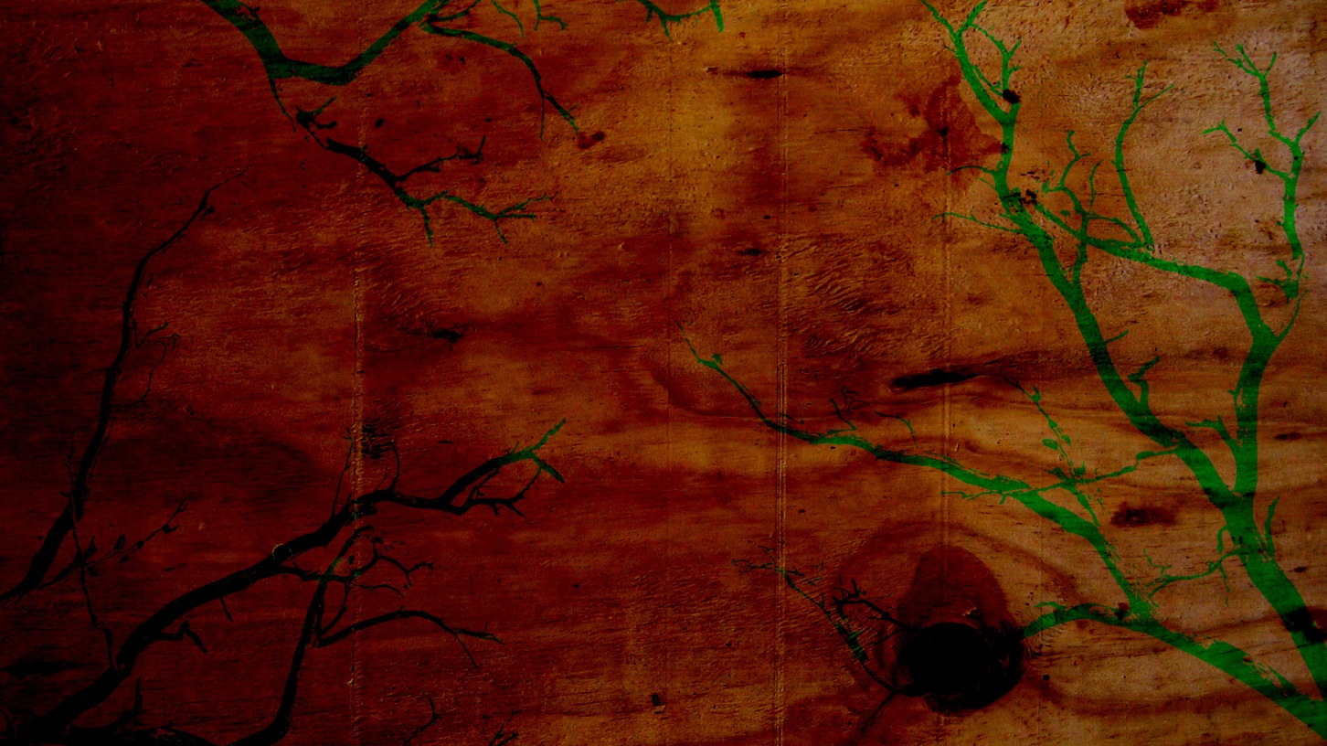
THE ATTRIBUTES OF GOD
Notes:
INSTRUCTIONS FOR THIS SECTION:
1. For each Scripture listed in the lesson for the given attribute, have one of the students read what they wrote down as the key part of the verse that best described the attribute.
2. Then give a brief definition of the attribute.
3. Dwell on and discuss the application of the attribute on our lives. This will turn into a praise and worship time of God.

Slide 13
THE ATTRIBUTES OF GOD
HOLINESS
Notes:
God is absolutely pure and perfect. (Most often repeated attribute of God in Scripture).
Supplemental Verses: Rev. 4:8—Holy, Holy, Holy –emphasis (Trinity?); Psalm 89:35
Application Questions:
when you dwell on God’s holiness, what is your response?
How does God’s holiness affect you practically?
How does God’s holiness affect your worship of God?
Application responses:
Fear over my sin
Unworthiness
the need for a Savior
Causes me to praise God for His majestic holiness

Slide 14
THE ATTRIBUTES OF GOD
Righteousness and Justice
Notes:
Review difference between Righteousness and justice.
righteous means that God only does that which is right; He does no wrong.
Justice is Gods legislating His righteous standards.
Supplemental Verses: Numbers 20:7-20 – Moses no go to promise land due to disobedience;
Matthew 5:48—God’s standard for man is perfection;
Hebrews 9:27—Unbelievers will be judged;
2 Corinthians 5:21—Believers have Christ’s imputed righteousness
Application Questions:
How does God’s righteousness affect you personally?
How does God’s righteousness affect your prayer life?
Application responses:
Drives us to a need for a Savior
God’s law must be the standard of my life
God’s judgment on unbelievers should cause me to witness
Causes me to be thankful for the righteousness that I have in Christ
Drives me to my knees, in humility, asking for forgiveness for my sinfulness

Slide 15
THE ATTRIBUTES OF GOD
Sovereignty
Notes:
God is subject to no one; He does as He pleases
Supplemental Verses: Romans 8:28—All things work together… according to His purpose
Application Questions:
How does God’s sovereignty affect you?
How does God’s sovereignty affect your worship of God?
Application responses:
Nothing Is out of God’s control
God is in control of my life; including my trials
I should STOP WORRYING
SECURITY—there is nothing that can separate us from Christ
I can praise God for His power.

Slide 16
THE ATTRIBUTES OF GOD
Eternality
Notes:
God has no beginning and no end
Supplemental Verses: John 3:16—He offers eternal life
Application Questions:
What significance does God’s eternality have on our salvation?
What consequences does it have for an unbeliever?
Application responses:
Our eternal salvation has meaning
Our hope of eternal life rests in God’s eternality
Praise: We will forever be in God’s presence
For the unbeliever—he will be eternally separated from God in hell

Slide 17
THE ATTRIBUTES OF GOD
Immutability
Notes:
God never changes His nature or purpose
Supplemental Verses: James 1:17 – God does not vary
Application Questions:
What application does God’s immutability have on our salvation?
What affect does it have on an unbeliever?
Application responses:
God will not change His mind about my salvation… the judgment of sin.

Slide 18
THE ATTRIBUTES OF GOD
Omniscience
Notes:
God is all-knowing
Supplemental Verses: Psalm 147:5– God has infinite understanding
Romans 11:33—34 God possesses all knowledge
Matthew 12:25; Isaiah 66:18—God knows man’s thoughts
Application Questions:
How does God’s omniscience affect your view of your sin?
How does God’s omniscience relate to God’s perfect justice?
How about God’s care for us?
Application responses:
God knows all my sin—I cannot hide from Him
God knows my thought life.
We can never sin and get away with it
He can be the perfect judge, since He knows all the facts perfectly
God know what is best for us
God knows us better than we know ourselves—He knows our future
God loves me even though He knows all the sins I will ever commit

Slide 19
THE ATTRIBUTES OF GOD
Omnipresence
Notes:
God is present everywhere
Supplemental Verses: Jeremiah 23:23-24– God is near
Application Questions:
What does it mean that God is near?
How does God’s omnipresence affect you?
How does God’s omnipresence affect your prayer life?
How about the indwelling of the Holy Spirit?
Application responses:
We cannot hide from God
We can be in God’s presence at all times
When we pray, God is near
the presence of the Holy Spirit is in every believer—all over the world

Slide 20
THE ATTRIBUTES OF GOD
Omnipotence
Notes:
God is all-powerful
(Make a point to Review these verses)
Supplemental Verses: Genesis 1:1, 27—Creator God
Hebrews 1:3—God upholds all things
Psalm 37:23-24—God controls our lives
Isaiah 41:10– God will uphold us
Application Questions:
When you stop and think about God’s power, what is your respons?
How aobut your problems, needs, prayer life, salvation?
Application responses:
God has the power to bring about all the promises He has made
No problem is too big for God
God has the power to provide for all of our needs
Our salvation is secure in His power

Slide 21
THE ATTRIBUTES OF GOD
Love
Notes:
LOVE:
ASK: From Romans 5:8… How does God demonstrate His love?
Supplemental Verses: 1 Corinthians 13:4-6—Love is patient, kind, etc.
Ephesians 2:4-5—God’s great love demonstrated in His mercy
1 John 4:19—”We love, because He first loved us.”
Application Questions:
How does God’s love affect you?
What should be your response to Gods Love
How should this affect your prayer life?
Application responses:
Our response should be to love God… through our obedience to Him
We should be thankful for His mercy
We should want to love others, like God loves us, in good deeds

Slide 22
THE ATTRIBUTES OF GOD
Truth
Notes:
Truth: God is absolute truth and His truth is firm
Supplemental Verses: John 14:6—Jesus is truth
John 16:13—The Spirit will guide you into all truth.
2 Timothy 2:15—God’s Word is truth (Scripture)
Romans 1:18-22—Unrighteous men suppress the truth.
John 8:32—God’s truth can make one free from sin.
Application Questions:
What should be your response to God’s truth?
How does the truth of God affect your life?
How do you view God’s Word and the truth it contains?
Application responses:
God’s Word is truth so I should be studying it
God’s truth should be the foundation of my life
God’s Word needs to permeate my life
I must share the truth of the gospel with others
God’s truth is powerful and can save.

Slide 23
THE ATTRIBUTES OF GOD
Mercy
Notes:
MERCY: is God’s compassion or forbearance upon those who have opposed His will
Supplemental Verses: Eph. 2:4-5—God being rich in mercy, saved us because of His great love.
1 Peter 1:3—God’s mercy is great and has cause us to be born again
Romans 3:25—Because of God’s forbearance, He passed over our sins
Eph. 4:2—We are exhorted to show forbearance to others.
Application Questions:
How does the mercy of God affect your life?
Why is God’s mercy called “great mercy” in 1 Peter 1:3?
What is your response when you think upon God’s mercy?
Application responses:
I am sinful and have violated God’s holiness. I am in need of God’s mercy
I am so thankful that God had mercy upon me and saved me
I am so thankful that God continues to have mercy upon me as every day I fall short of His holiness
I am not worthy of God’s mercy
Because God showed mercy to me, I should show mercy to others

Slide 24
Conclusion
Fear God
Desire to know God
Proclaim God
Notes:
CONCLUSION:
Fear God—Proverbs 9:10; Revelation 15:4 (to fear God is to revere and worship Him)
Desire to know God—Psalm 27:8
Proclaim God—1 Peter 2:9
Take some time to discuss the answers to the application questions in the final section.
These are issues we can benefit from pondering ahead of time,
rather than waiting until they happen and then try to figure out how we should respond
Final Exhortation, say: I want to exhort/encourage you to reflect upon God’s attributes when you pray.
Close with a time of prayer focusing on praising God’s attributes.

Slide 27
Give Us Clean Hands
We bow our hearts We bend our knees
Oh Spirit come make us humble
We turn our eyes from evil things
Oh Lord we cast down our idols

Slide 28
Give Us Clean Hands
Give us clean hands give us pure hearts
Let us not lift our souls to another (repeat)
And oh God let us be a generation that seeks
That seeks your face oh God of Jacob (repeat

